Slide 1




Pan-European Quantum Internet Hackathon 2024
Grover Search using Blind Quantum Computation
Quantum Communication Networks Research Group
(Qcnets)
Centre for Tactile Internet with Human-in-the-loop (CeTI)
Milad
Bunie
Samuel
Mohamed
Idham
Dresden, Friday, January 16, 2024

Slide 2
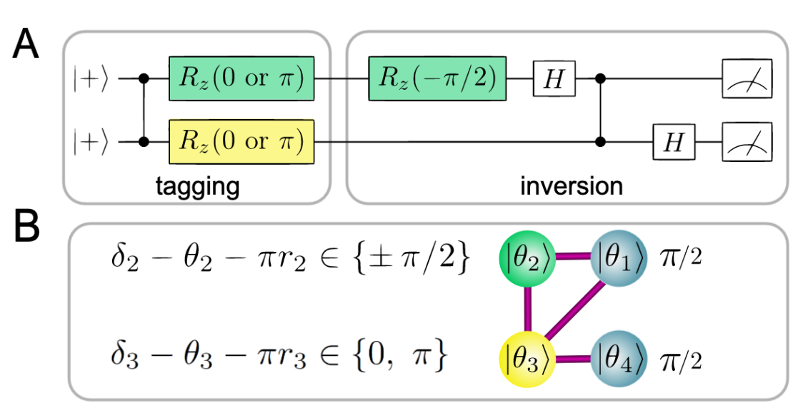
Challenges Task for the Hackathon
Page 2
Steps of the challenge:
Create the four-qubit cluster state by initalizing all qubits on the server in the |+> state and performing local complementation on qubit 2.
Verify that you can perform a single-step Grover search on this state using the method from. Compare this to the equivalent quantum circuit.
Send a qubit from a client and use this qubit to control the measurement angle of a qubit in the resource state.
Execute the Grover circuit by teleporting two client qubits, and sending the necessary classical information to the server.
A
B
Science, 335 (2012) 303-308

Slide 3
Motivation
Page 3
In traditional communication systems, information can be intercepted and read by unauthorized parties, posing a risk to the confidentiality of sensitive data.
A secure communication that utilizes the principles of quantum mechanics to ensure the privacy and security of transmitted information.
Proposed Solution
We propose the solution of using Blind Quantum Computation with Grover‘s algorithm.

Slide 4
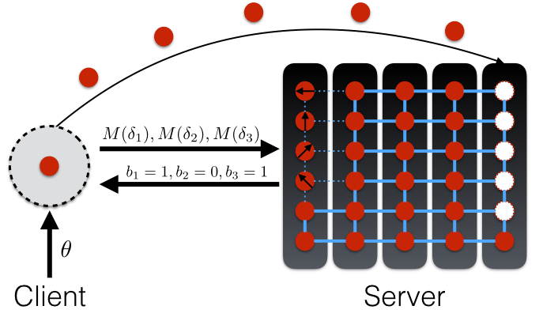
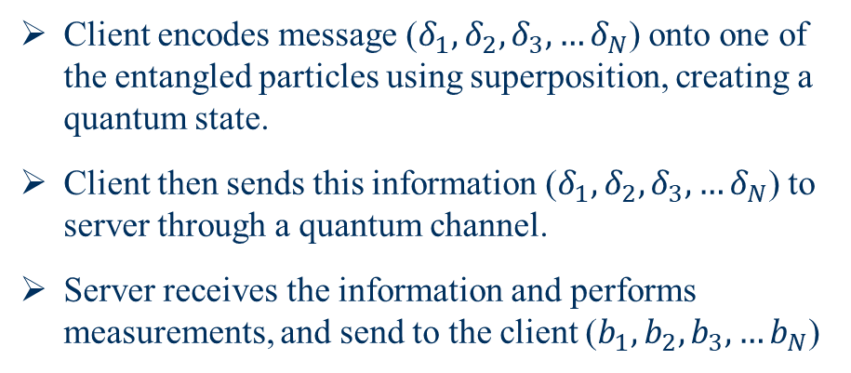
Blind Quantum Computation
Page 4
Definition
The Blind computing shows that the client delegate a computation task to a server, where the input and algorithm is hidden from the server.
By all means, client sends message to an untrusted server.
How
Client encodes message ($δ_{1},δ_{2},δ_{3}, …δ_{N}$) onto one of the entangled particles using superposition, creating a quantum state.
Client then sends this information ($δ_{1},δ_{2},δ_{3}, …δ_{N}$) to server through a quantum channel.
Server receives the information and performs measurements, and send to the client ($b_{1},b_{2},b_{3}, …b_{N}$)

Slide 5
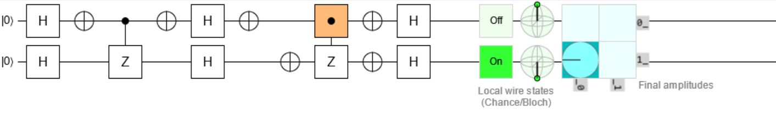
Grover Algorithm
Page 5
In classical computing, searching an unsorted database of N items requires O(N) operations on average to find a specific item
It can achieve this task with only O(√N) operations, providing a quadratic speedup over classical algorithms.
The key idea behind the Grover algorithm is to use quantum parallelism and interference to amplify the probability of finding the correct solution while suppressing the probabilities of incorrect solutions
Oracle
Amplification
Measurements

Slide 6
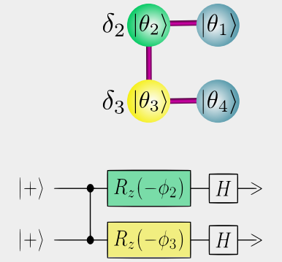
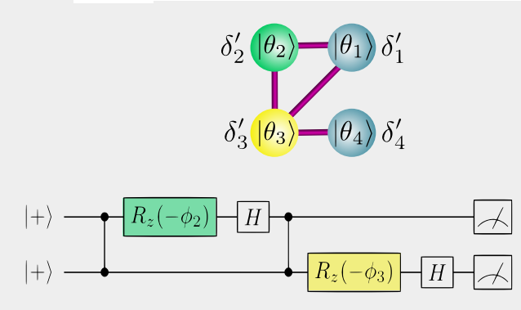

We create the four-qubit cluster state by initializing all qubits on the server in the |+> state.
Page 6
We perform a local complementation on qubit 2.
Science, 335 (2012) 303-308

Slide 7
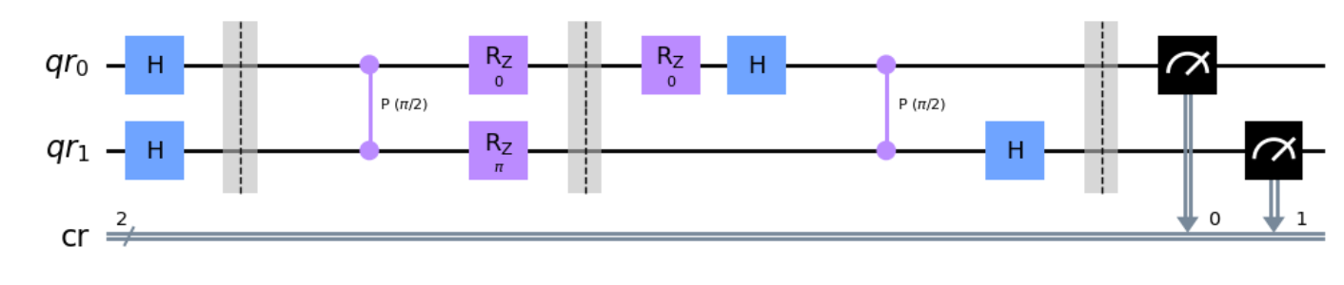
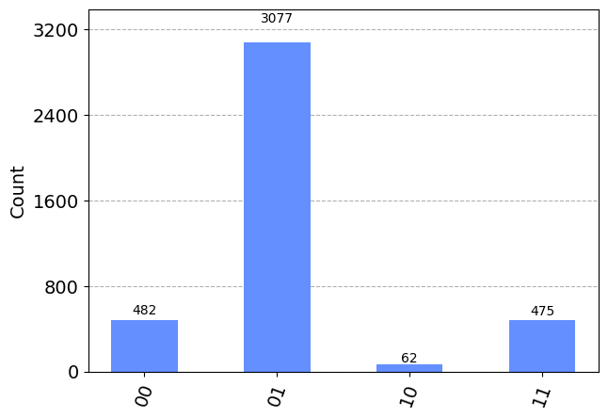
We can perform a single-step Grover search on this state using the BQC method.
Page 7

Slide 8
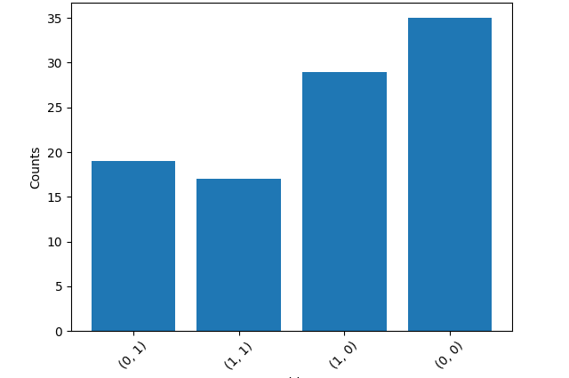
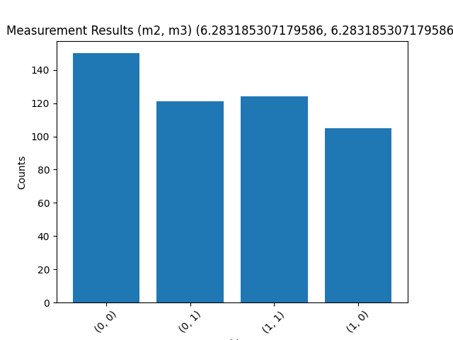


Page 8
We send a qubit from a client and use this qubit to control the measurement angle of a qubit in the resource state.
$θ_{1}=2π$, $θ_{2}=π$
$θ_{1}=2π$, $θ_{2}=2π$

Slide 9
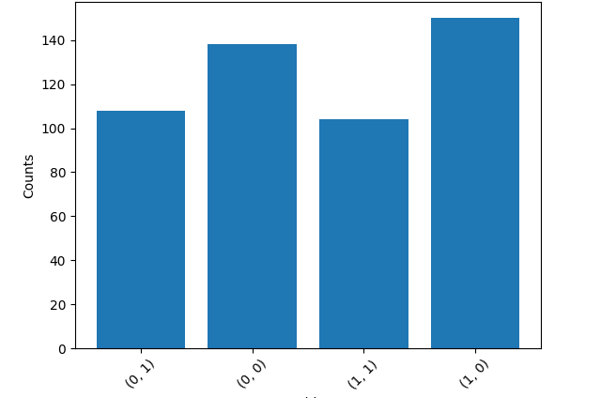
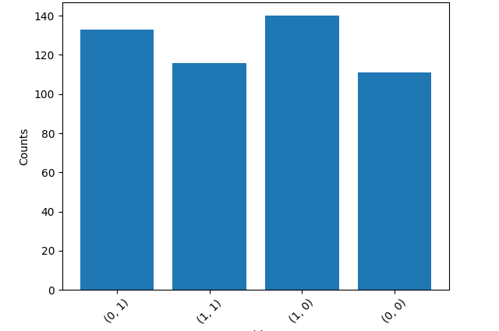


We execute the Grover circuit by teleporting two client qubits, and sending the necessary classical information to the server.
Page 9
$θ_{1}=π$, $θ_{2}=π$
$θ_{1}=2π$, $θ_{2}=2π$

Slide 10
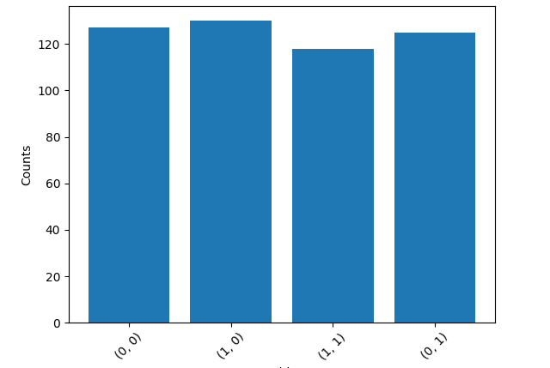
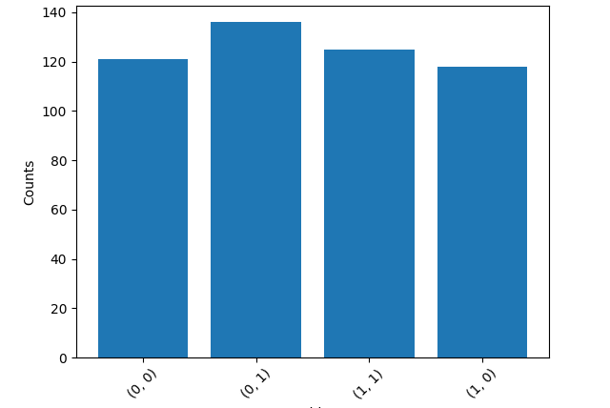


Page 10
$θ_{1}=π$, $θ_{2}=2π$
$θ_{1}=5π$, $θ_{2}=2π$

Slide 11
Page 11
Conclusion:
Using the Blind quantum computing (Grover’s Algorthim):
We create the four-qubit cluster state by initializing all qubits on the server in the |+> state.
We perform a local complementation on qubit 2.
We perform a single-step Grover search on this state using the BQC method.
The measurement angle of a qubit in the resource state is accomplished.

